Slide 1
Azure Study Group AZ-300 - Microsoft Azure Architect Technologies
Shawn Weisfeld
Cloud Solution Architect

Slide 2
Week 3 Create and deploy apps (5-10%)

Slide 3
Agenda
Agenda
1
Speaker Introduction
2
Feedback Loop
3
Objective Review
4
Open Mic
5

Slide 4
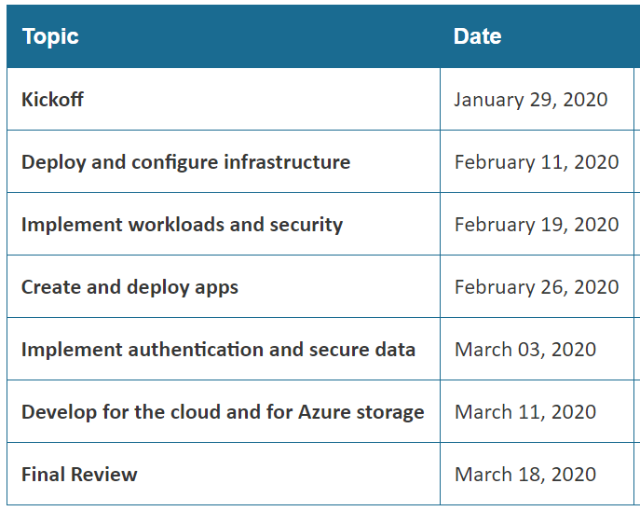
Series Agenda
Yammer: https://aka.ms/azurecsg
Homework:
https://aka.ms/AZ-300StudyGroup

Slide 5

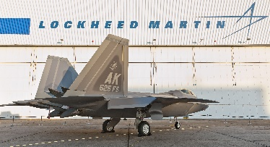




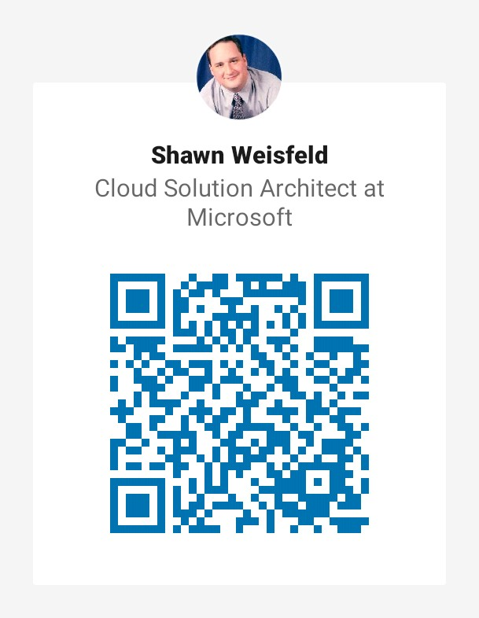


















Slide 6
Feedback Loop

Slide 7
Create web apps by using PaaS
create an Azure app service Web App
create documentation for the API
create an App Service Web App for Containers
create an App Service background task by using WebJobs
enable diagnostics logging

Slide 8
Design and develop apps that run in containers
configure diagnostic settings on resources
create a container image by using a Dockerfile
create an Azure Kubernetes Service
publish an image to the Azure Container Registry
implement an application that runs on an Azure Container Instance
manage container settings by using code

Slide 9


Questions?

Slide 10
Homework Assignment
https://aka.ms/AZ-300StudyGroup

Slide 11

Open Mic …

